Slide 1
Information encoding standards final project GROUP 5

Slide 2



Rohan Patel
200590360
Jay Patel
200590367
Team
Jaymin Adhikari
200520946
2

Slide 3
Introduction
In this project we are going to explore about the ASP.net Authentication and Authorization.
Role based authorization : Manager , User and Admin
Since this is going to be the role bases authorization only authorized users can do some modification in the web application
Web application is created with the asp.net framework which is reliable and flexible platform for building modern applications. It gives wide variety of tools and features that will help developers to make high-performance applications.

Slide 4
Objectives
Creating Web application that enables users to manage their contacts.
Security groups : To categorise people according to their group and assign them a role
Role based authorization to restrict access of the certain feature.

Slide 5
Benefits
Enhance security of the application : As certain person do certain thing which will enhance the security of the application which safeguard the information
Customized user application
Data privacy

Slide 6
Project – Authentication and authorization
User can make contacts or update / delete their own listed contacts
Admin can Add contacts , Update , delete anyone’s contacts and reject the approved contacts
Manager can Approve the submitted request or reject the submitted request and add the contacts.

Slide 7
User
View all approved contacts: Registered users can see all contacts that have been authorized and made publicly accessible by the system administrators. This includes any contact information deemed appropriate for public consumption.
Edit and delete their own contacts: Registered users can change or delete the contacts they have provided to the system. Users can edit their contact information or delete any such contact if they wish to no longer relate to it.
User don’t have access to update or delete data of another user’s contacts which preserves the data integrity

Slide 8
admin
Accept or reject any data: Administrators have authorization to examine and assess any submitted data made by logged-in users. They can judge the content's value, applicability, and adherence to platform rules.
Admin can do :
accept and reject requests
update outdated info
can remove contacts and update contacts

Slide 9
Manager
Managers belong to a higher privilege user group with access to features beyond what Registered Users have.
They can approve and reject the applications
Managers have the same rights as registered users, including profile management and access to public resources.
They can also manage resources within their authority, such as creating, modifying, and deleting content. For example, a content manager can write and edit contacts which they’ve made.

Slide 10
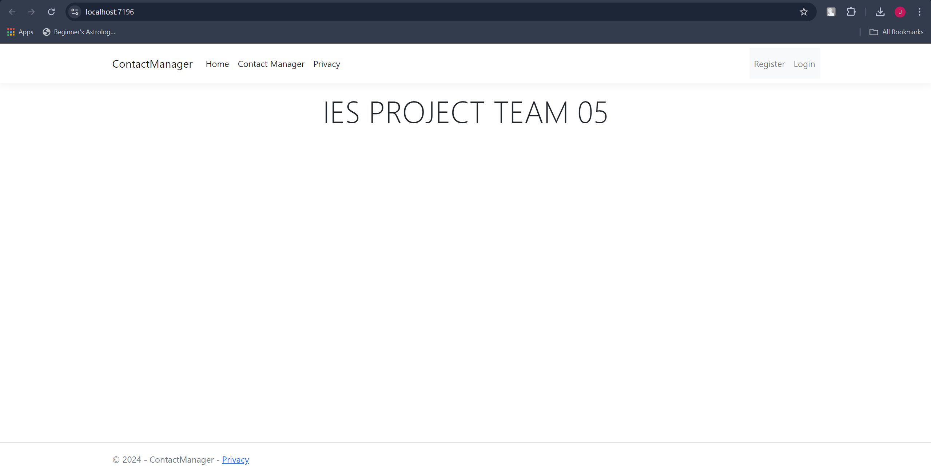
Implementation

Slide 11
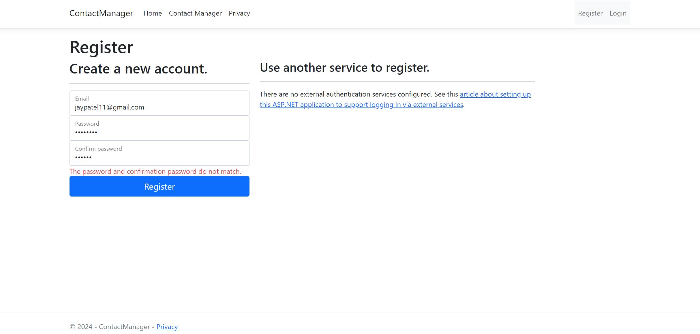

Slide 12
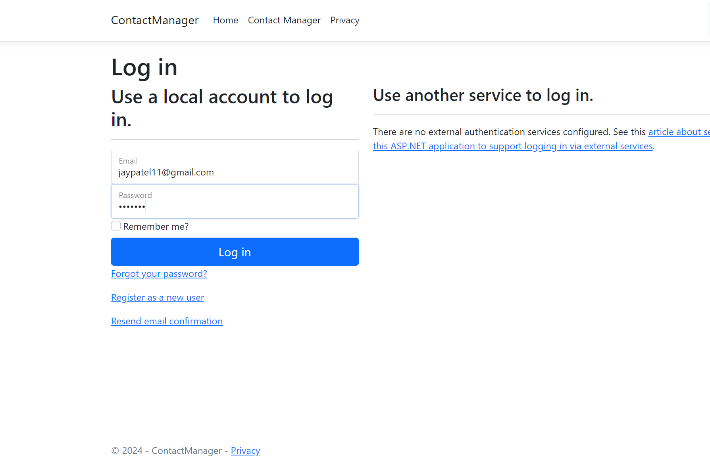

Slide 13
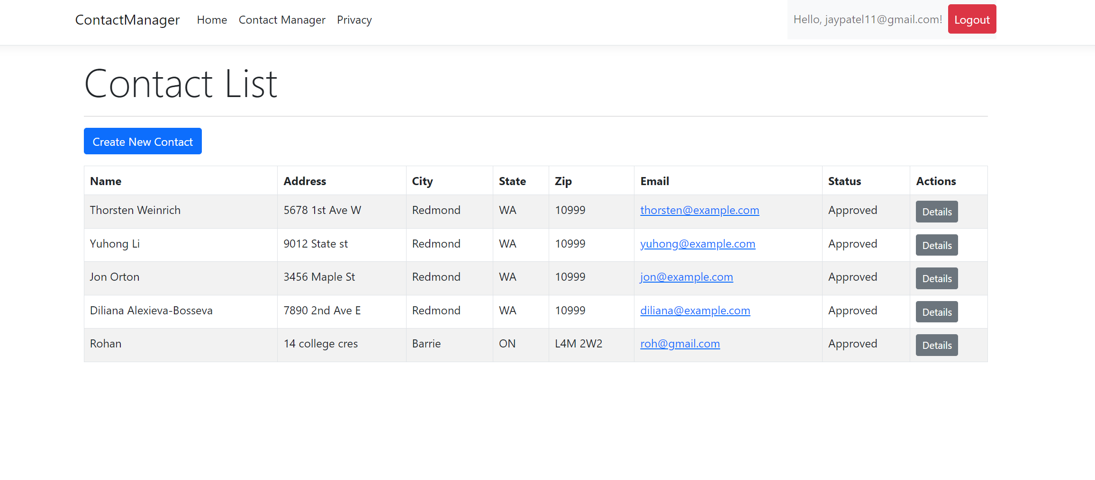
All contact details

Slide 14
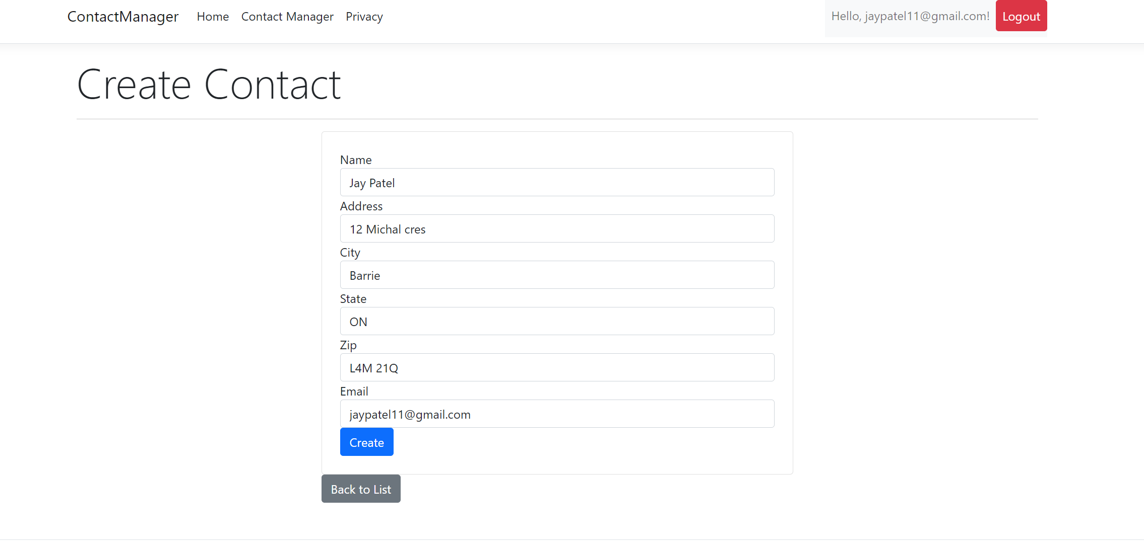
Create contact for user
Market gap: few, if any, products on the market help customers like we do
Customers: 66% of US consumers spend money on multiple products that only partially resolves their issue
Financials: millennials account for about a quarter of the $48 billion spent on other products in 2018
Costs: loss of productivity costing consumers thousands of dollars
Usability: customers want something easy to use that helps make their life easier

Slide 15
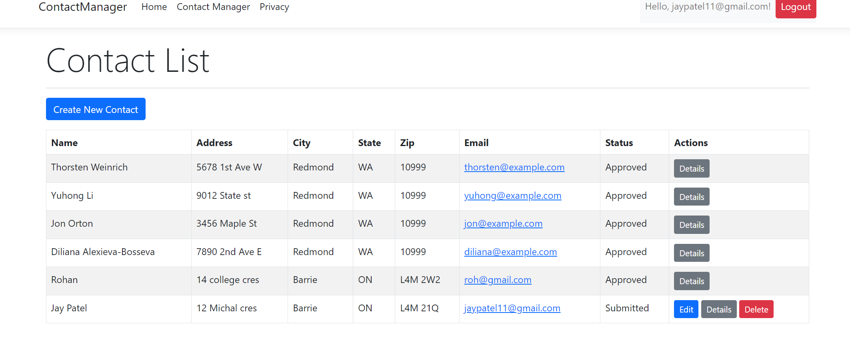
Contact list
Online store and market swap

Slide 16
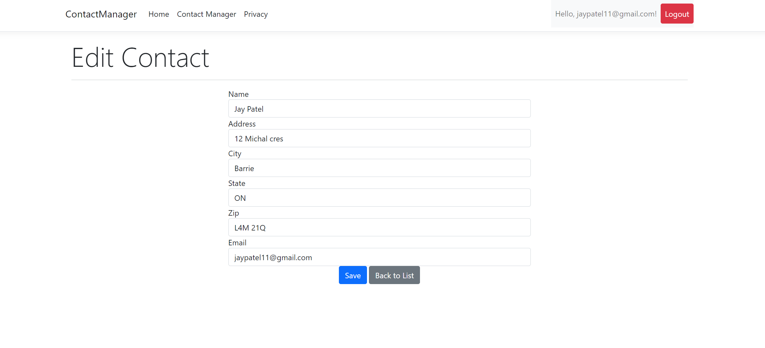
Edit contact for user

Slide 17
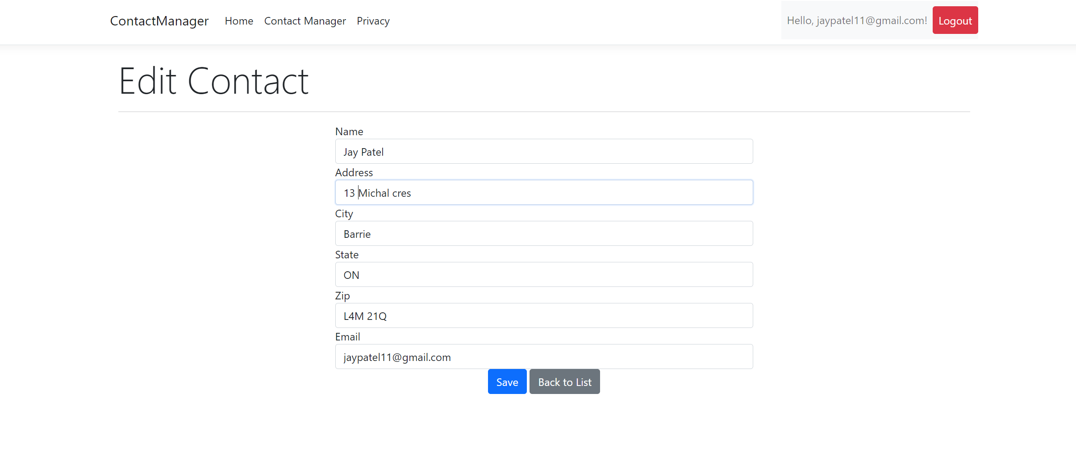
UPDATED CONTACT DETAILS

Slide 18
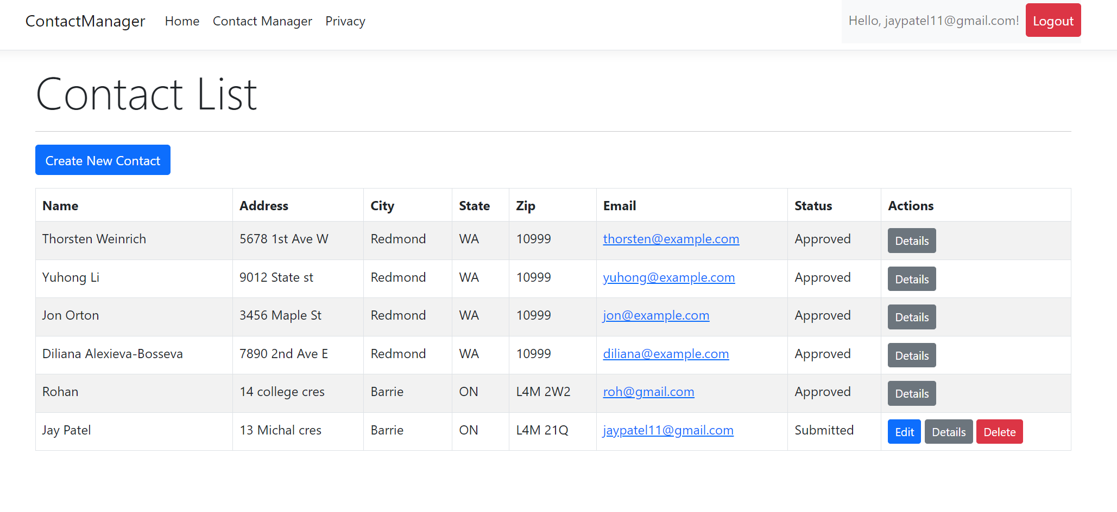
Growth strategy
Feb 20XX: roll out product to high profile or top-level participants to help establish the product
May 20XX: release the product to the public and monitor press release and social media accounts
Oct 20XX: gather feedback and adjust product design as necessary

Slide 19
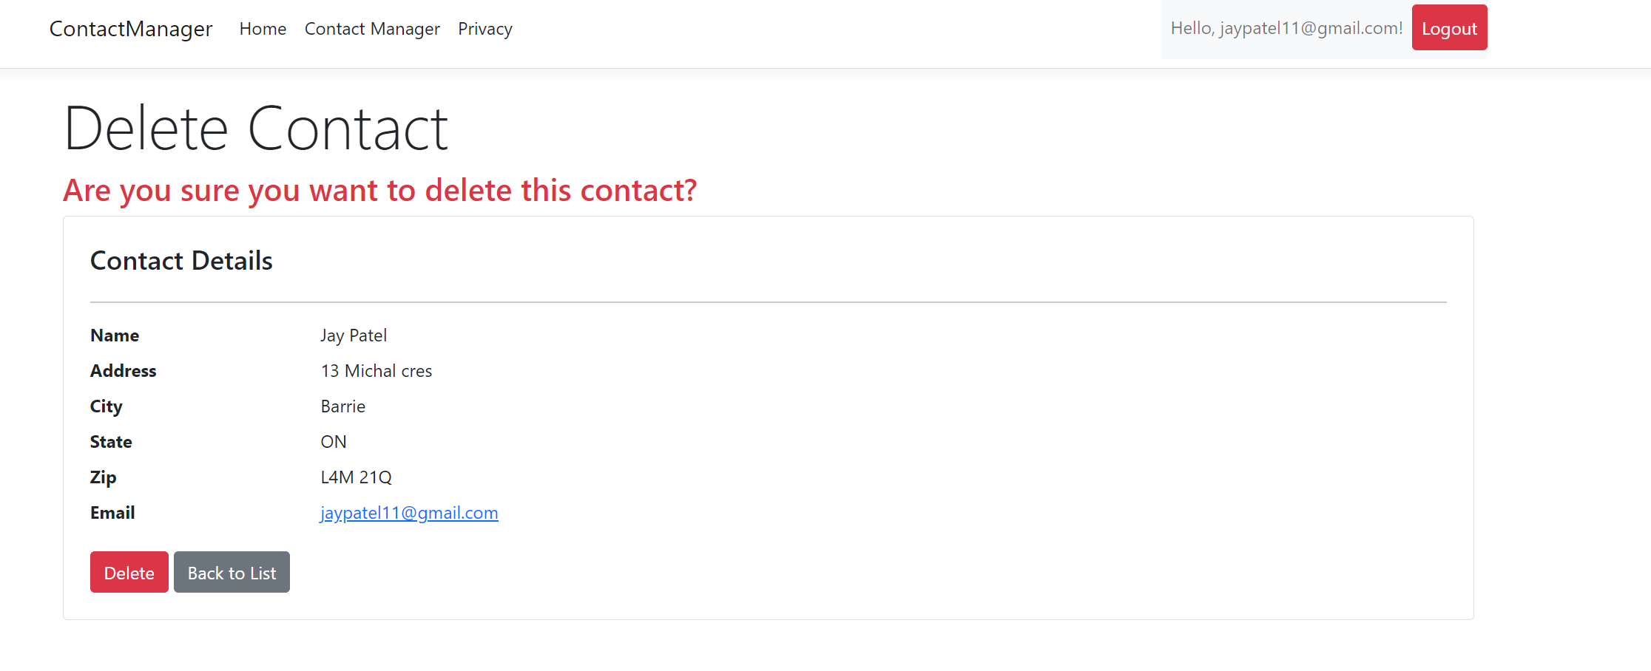
Market overview

Slide 20
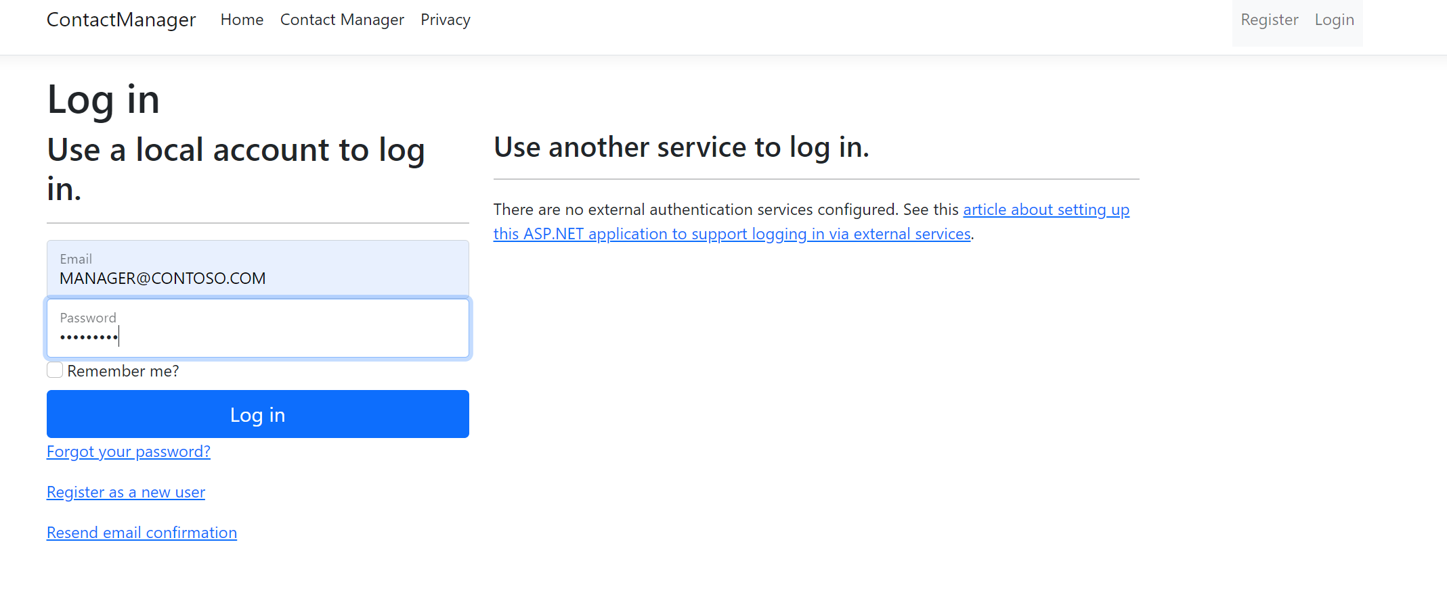
Login for the manager
Manager can approve and reject the request of the user contact

Slide 21
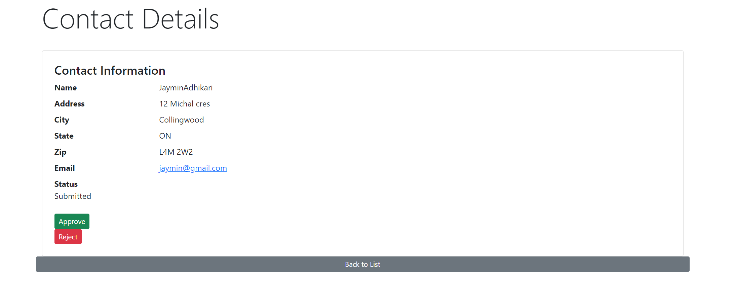
Financials

Slide 22
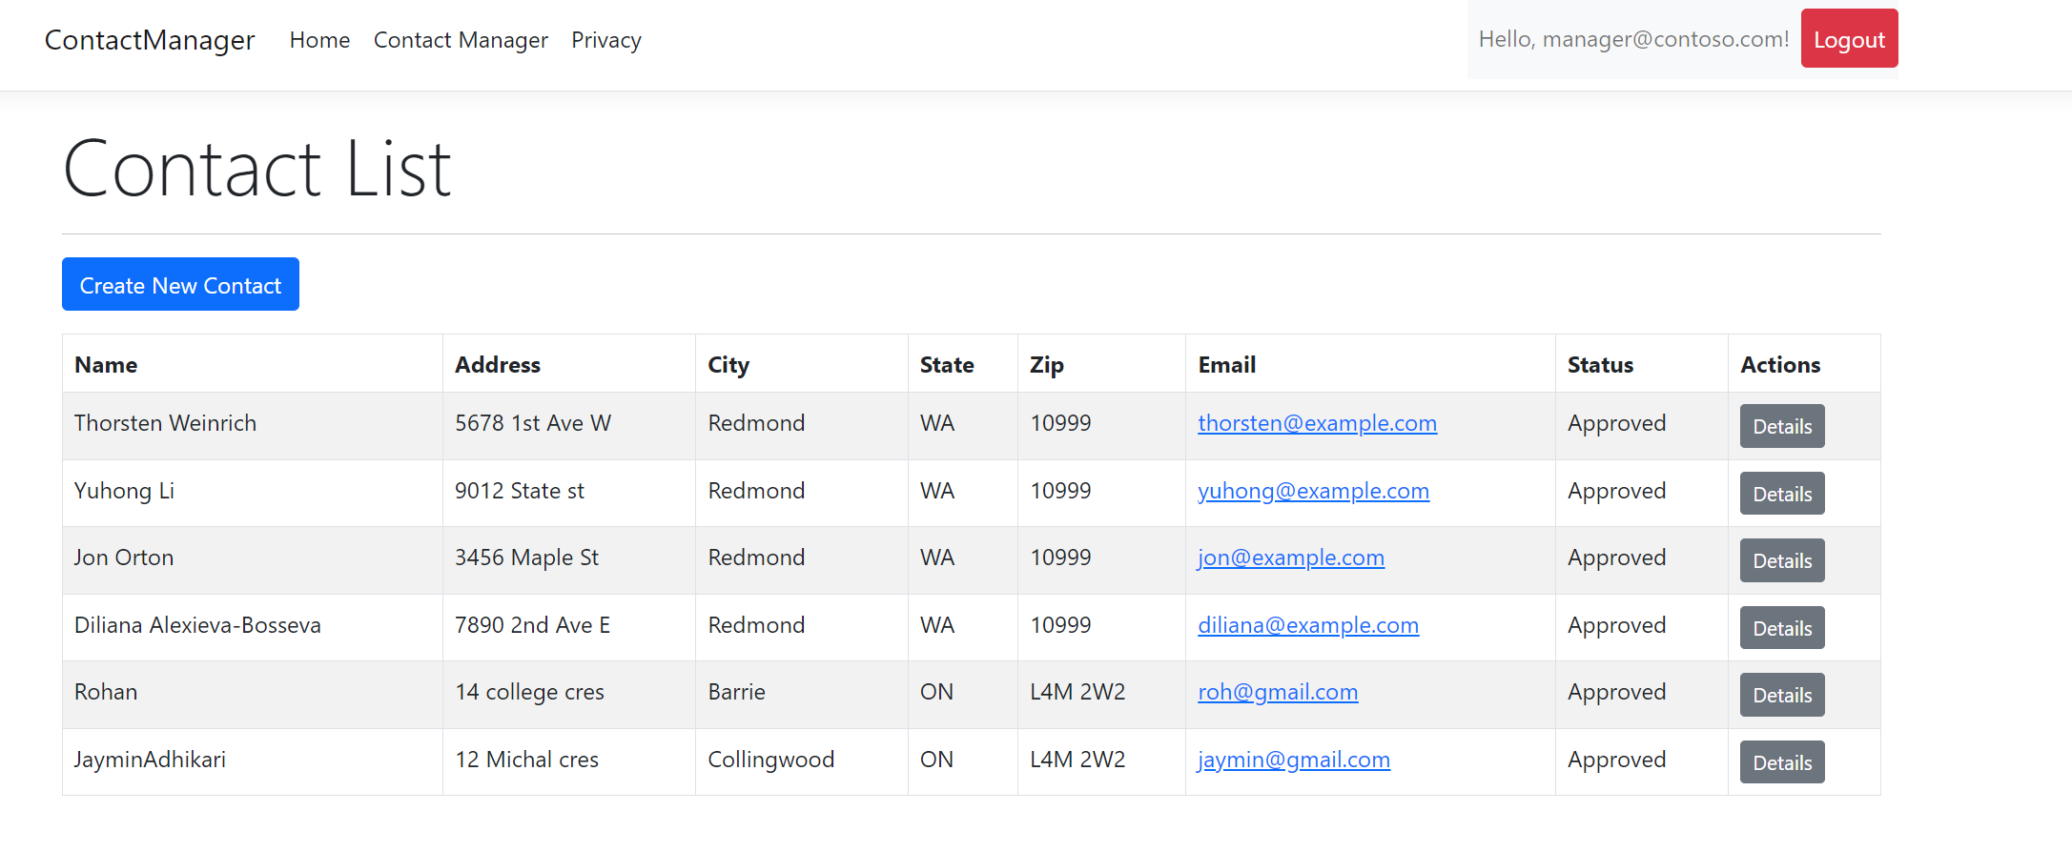
Main screen for the manager

Slide 23
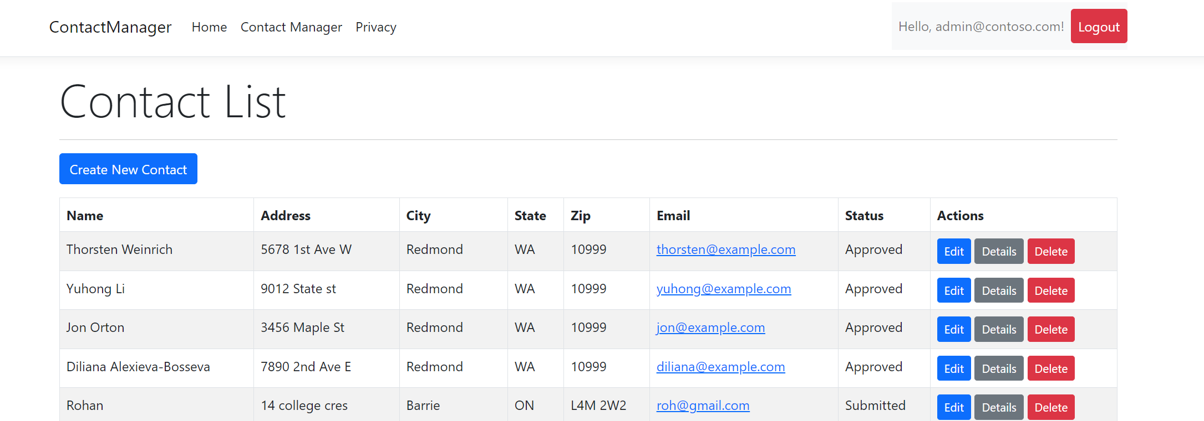
ADMIN SCREEN – CAN UPDATE , DELETE AND EDIT DETAILS

Slide 24
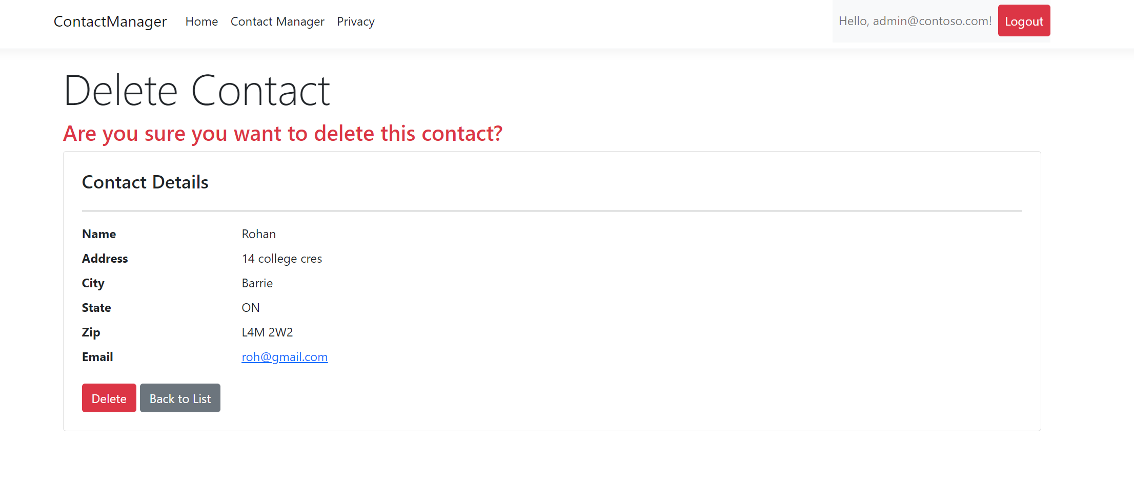
Delete contact screen for the admin

Slide 25
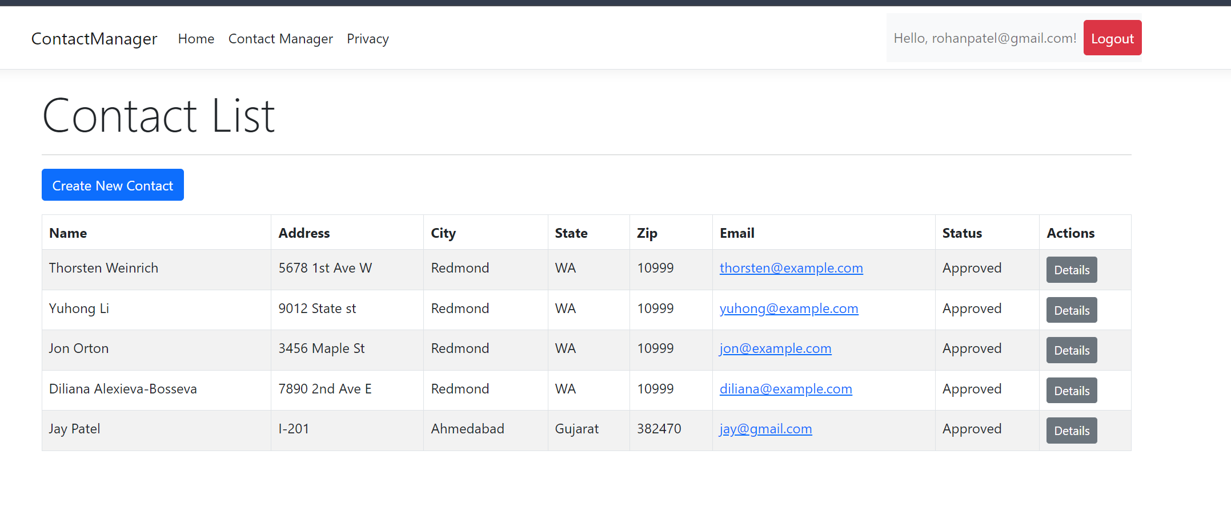
Contact details for the another user who can only see the approved id

Slide 26

Thank you
GROUP 5 IES PROJECT

